Slide 1
Statistical arbitrage with cointegration
Statistical arbitrage refers to strategies that employ some statistical model or method to take advantage of what appears to be relative mispricing of assets
Notes:
认识到balance之后去抓住mispricing

Slide 2
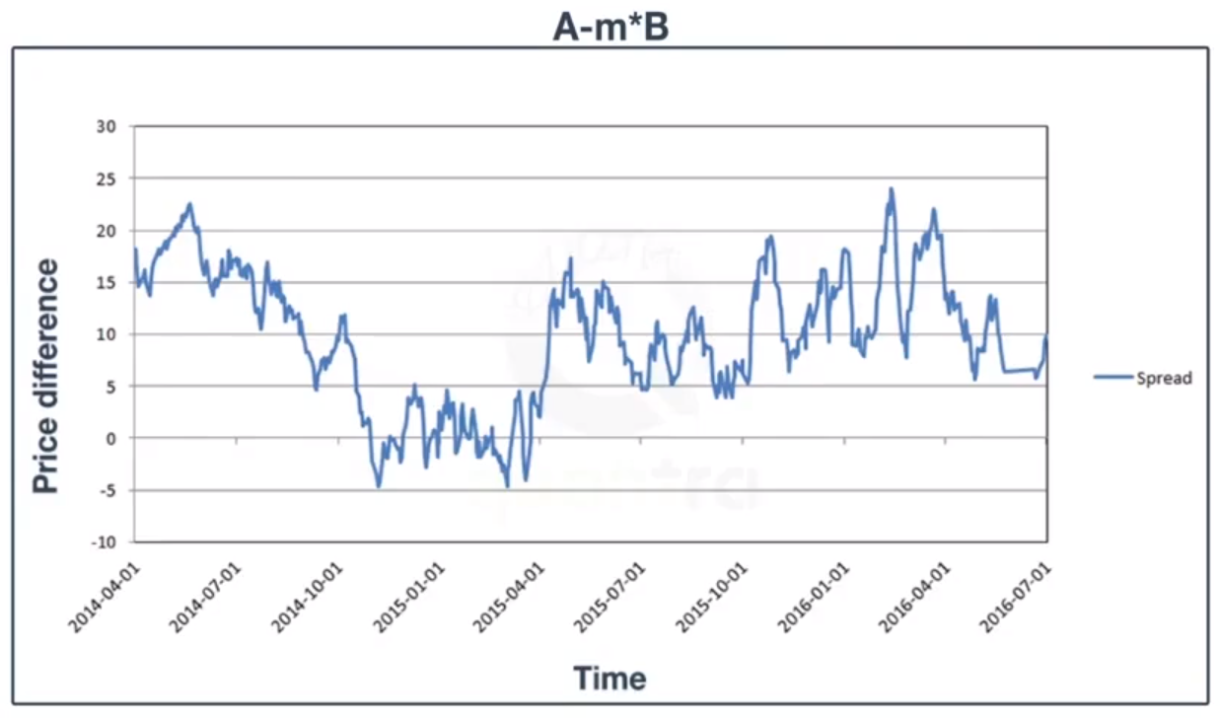

人狗协同与“协整”
Pairs trading is to find two assets whose prices have historically moved together, track
the spread (the difference between their prices, eg: A-m*B), and, once the spread widens, buy the loser that has dropped below the common trend and short the winner.
Notes:
人和狗单独来看，他们是一种漫游的状态，因此他们是在随机游走，但是由于各自的脚底的触觉，视觉等，使他们的各自在自己的道路上行走，因而他们之间的距离是有界的。
笼统来说，他们之间的距离是stationary的。均值方差。
Stationarity
在交易层面A-m*B为做多A，做空B，打包形成一个pair产品。
圆圈处，产品正向操作。统计套利的本质就是统计概率上的优势，人上走，狗下走，期待的最理想的结果。即便不处于边界，但对于整体而言盈利的概率是随着spread的减小而增大的（可能性与幅度）。

Slide 3
In practice, the strategy requires two steps:
Formation phase: Identify securities that have a long-term mean-reverting relationship. Ideally, the spread should have a high variance to allow for frequent profitable trades while reliably reverting to the common trend.
2. Trading phase: Trigger entry and exit trading rules as price movements cause the spread to diverge and converge.
there are numerous parameters that we need to define for implementation.
• Investment universe to screen for potential pairs or baskets
• Length of the formation period
• Strength of the relationship used to pick tradeable candidates
• Degree of deviation from and convergence to their common means to trigger entry or exit trades or to adjust existing positions as spreads fluctuate
Notes:
①a sample of 172 stocks and 138 ETFs traded on the NYSE and NASDAQ, with daily data from 2010 - 2019 provided by Stooq.
标的池预筛选时：流动性好的10%或者市值最高的10%
②4 years of daily data:
③Johansen test critical value的选取，波动性的筛选
④diverge波峰与波谷的判断entry，converge的判断触及MA exit

Slide 4
Pairs trading in practice
The example code uses a sample of 172 stocks and 138 ETFs traded on the NYSE and
NASDAQ, with daily data from 2010 - 2019 provided by Stooq.
The securities represent the largest average dollar volume over the sample period in
their respective class; highly correlated and stationary assets have been removed.
compute_pair_metrics() computes the following distance metrics for over 23,000 pairs of
stocks and Exchange Traded Funds (ETFs) for 2010-14 and 2015-19:
• The drift of the spread, defined as a linear regression of a time trend on the spread
• The spread's volatility
• The correlations between the normalized price series and between their returns
Low drift and volatility, as well as high correlation, are simple proxies for cointegration
We follow the recommendation by Gonzalo and Lee (1998), mentioned at the end of the
previous section, to apply both tests and accept pairs where they agree.
For the over 46,000 pairs across both sample periods, the Johansen test considers 3.2 percent of the relationships as significant, while the Engle-Granger considers 6.5 percent. They agree on 366 pairs (0.79 percent).

Slide 5
Getting entry and exit trades
We also calculate a Bollinger Band because we will consider moves of the spread larger than two rolling standard deviations away from its moving average as long and short entry signals, and crossings of the moving average in reverse as exit signals.
Boll 线是一种常见的技术分析方法，该策略属于通道突破类策略的一种。其具体操作
方式如下：
➢ 中枢 = N 日移动平均线；
➢ 上轨 = 中枢 ＋ k * Std(N)；
➢ 下轨 = 中枢 － k * Std(N)；
其中 k 为参数，表示布林带的宽度，Std(N)是价格的 N 日标准差。k 越大趋势越不容
易确认，胜率较高，但是交易次数更少；k 越小趋势越容易确认，胜率较低，但是交易次
数比较多。

Slide 6
One of the major concerns with this strategy is that the hedging ratio(A-m*B) between the two assets, is likely to be time-varying. That is, they are not fixed throughout the period of the strategy. In order to improve profitability it would be useful if we could determine a mechanism for adjusting the hedging ratio over time.
One approach to this problem is to utilise a rolling linear regression(A=m*B+n) with a lookback window. This involves updating the linear regression so that the slope and intercept terms "follow" the latest behaviour of the cointegration relationship. However it also introduces another free parameter into the strategy, namely the lookback window length. This must be optimised, often via cross-validation.
Notes:
有截距无

Slide 7
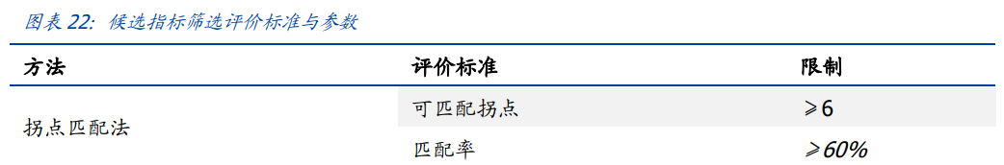
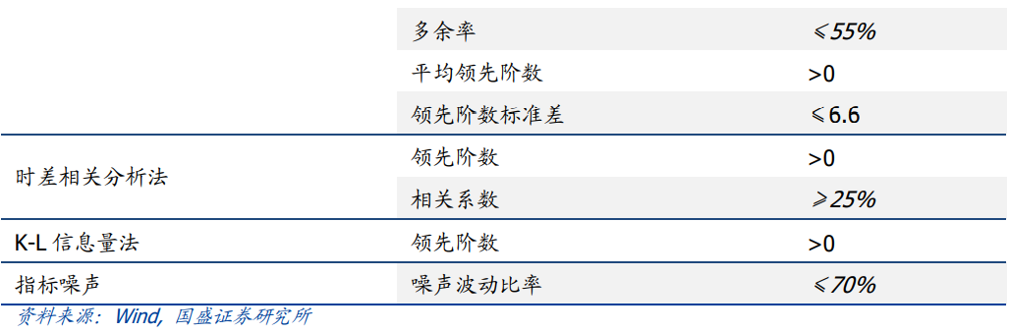
Notes:
不是滞后那么简单
时差相关分析是用来判断经济指标的领先与滞后阶数的常用方法，该方法通过计算领先
与滞后 N 期的候选指标与基准指标间的相关系数，选择相关系数最大的阶数作为领先或
滞后阶数
K-L 信息量是用来衡量两列数据概率分布的相似程度
季节性调整（求同比）、HP滤波

Slide 8
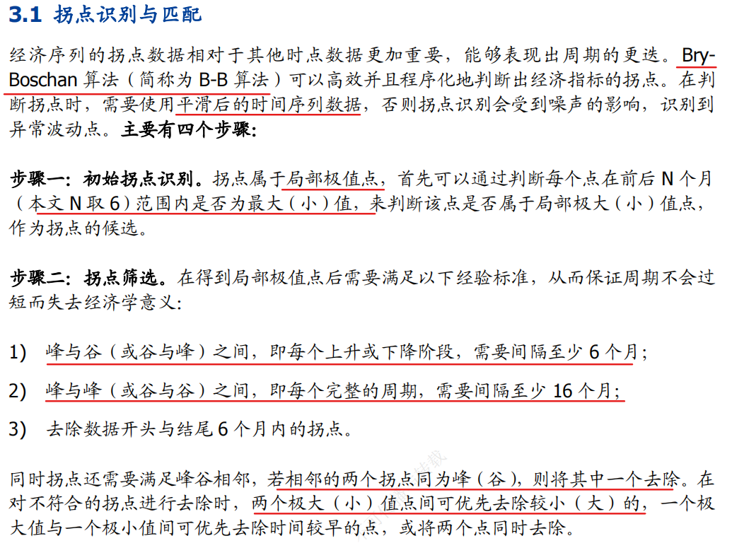

Slide 9
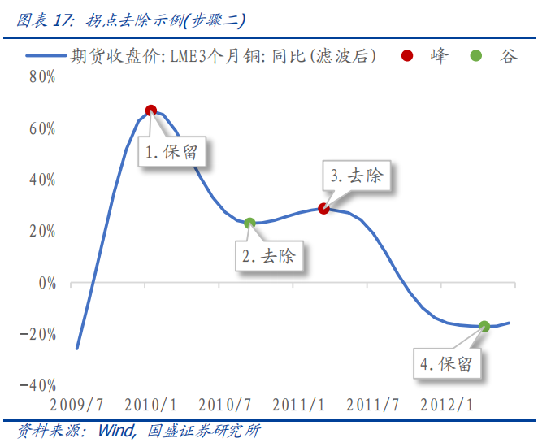

Slide 10
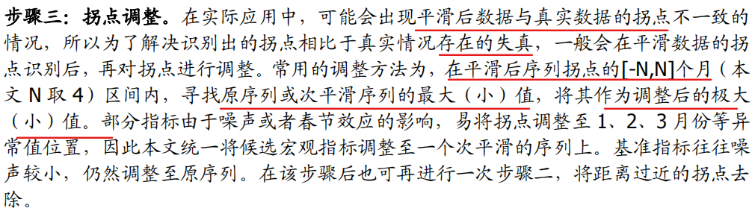
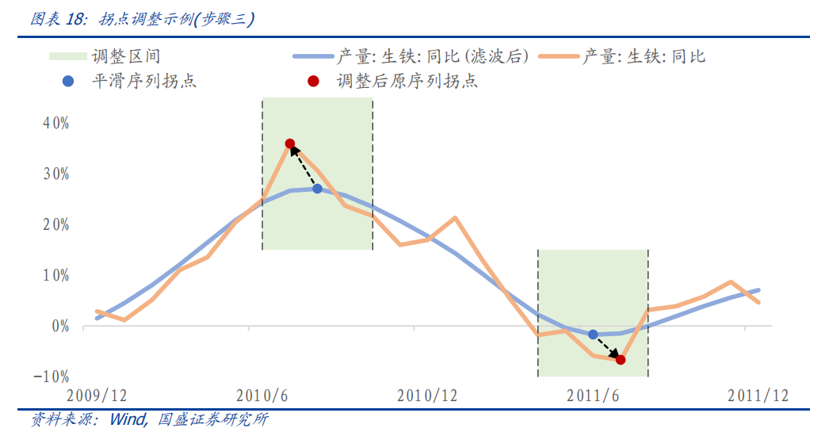

Slide 11
